Slide 1

E-safety Awareness
for
Parents and Carers

Slide 2
This picture shows the speed at which the internet is changing the world.

Slide 3
The online sites on the previous image are becoming overwhelmingly popular for both adults and children as the online world is increasingly integrated into our daily lives.

Slide 4
Children are natives in the online world, most are unaware of life without:
–IPhone
–Games consoles
–Google
–Social Media
They feel confident using new sites and technologies, moving from site to site with ease.

Slide 5
“70% of parents of children aged 12 –15 feel that their children know more about the internet than they do”
(Ofcom Media Literacy 2011)

Slide 6
There are may positive aspects of being online.
What skills do you think your children are learning whilst they are online, whether networking, gaming or doing homework?

Slide 7
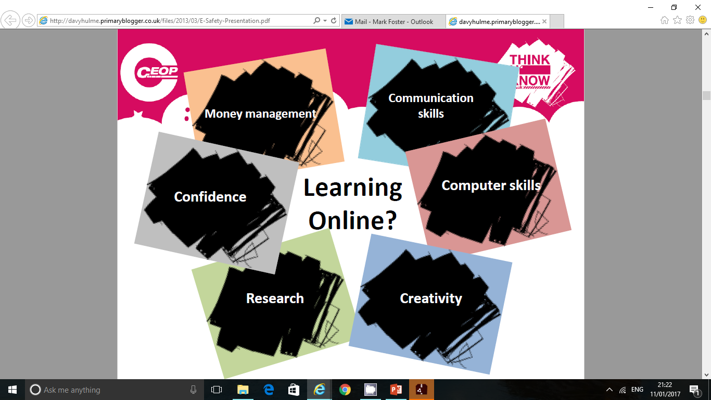

Slide 8
However there are many potential risks:
Too much screen time
Cyber bullying
Grooming
Inappropriate websites/ images/ videos
Giving out too much information online
Viruses, hacking and security

Slide 9
“Today, social media is all around us; making it simpler to communicate and make contacts, opening doors to new exciting opportunities for creativity and education.”
CEOP 2011

Slide 10
Social Media
Social media has exploded into our lives, with many of us feeling pressure to join in or miss out.
Examples of social media include: Facebook, Twitter, Instagram, YouTube, TikTok.
These sites allow us to connect with friends and communicate in different ways.

Slide 11
Statistics
(2017 – childnet survey ages 8 - 17)
(56%) of young people said they have shared images or videos on a public social media profile, with almost a third (31%) saying that most of the photos they share are on a public profile that can be seen by anyone.
23% said they did not know how to control what could be seen on their social media profiles.
70% of 8-17s said they have seen images and videos not suitable for their age in the last year

Slide 12
Gaming
Many online games have communication features which allow their users to interact anonymously e.g. Minecraft.
Cyberbullies may harass fellow gamers and online scam artists may promise virtual goods in an effort to get credit card information.
Most game consoles allow internet access, so it is important to be aware of their communication features.

Slide 13
Top Tips for parents
Be a part of the child’s online life; involve the whole family and show an interest. Find out what sites they visit and what they love about them.
No filter or parental controls tool are 100% effective, and many of the risks that young people face online are because of their own and other’s behaviour.
Create a family agreement for internet use, such as on http://www.childnet.com/resources/know-it-all-for-parents/kiafp-cd this helps to establish safe and responsible use of technology.

Slide 14
SMART RULES FOR USING THE INTERNET
SMART RULES FOR USING THE INTERNET
S is for SAFE
Never give out personal information if you are chatting or posting online.
Personal information:-
your name
your school
where you live
email address
phone number
passwords

Slide 15
SMART RULES FOR USING THE INTERNET
SMART RULES FOR USING THE INTERNET
M is for MEETING
Meeting someone you have only been in touch with online can be dangerous.
Only do so with your parents’ or carers’ permission and even then only when they can be present.
Remember online friends are still strangers even if you have been talking to them for a long time.

Slide 16
SMART RULES FOR USING THE INTERNET
SMART RULES FOR USING THE INTERNET
A is for ACCEPTING
Accepting emails, messages, or opening files, pictures or texts from people you don’t know or trust can lead to problems – they may contain viruses or nasty messages!

Slide 17
SMART RULES FOR USING THE INTERNET
SMART RULES FOR USING THE INTERNET
R is for RELIABLE
Someone online might lie about who they are.
Information on the internet may not be true.
Always check information with other websites, books or someone who knows. If you like chatting online, only chat to your real world friends and family.

Slide 18
SMART RULES FOR USING THE INTERNET
SMART RULES FOR USING THE INTERNET
T is for TELL
Tell your parent, carer or a trusted adult if someone or something makes you feel uncomfortable or worried, or if you or someone you know is being hurt online.

