Slide 1
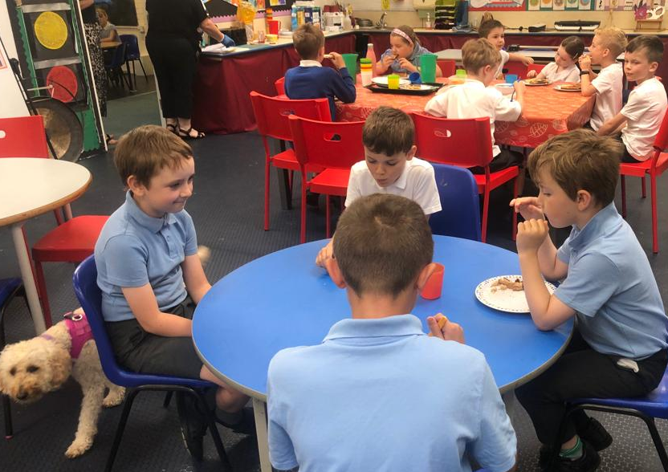
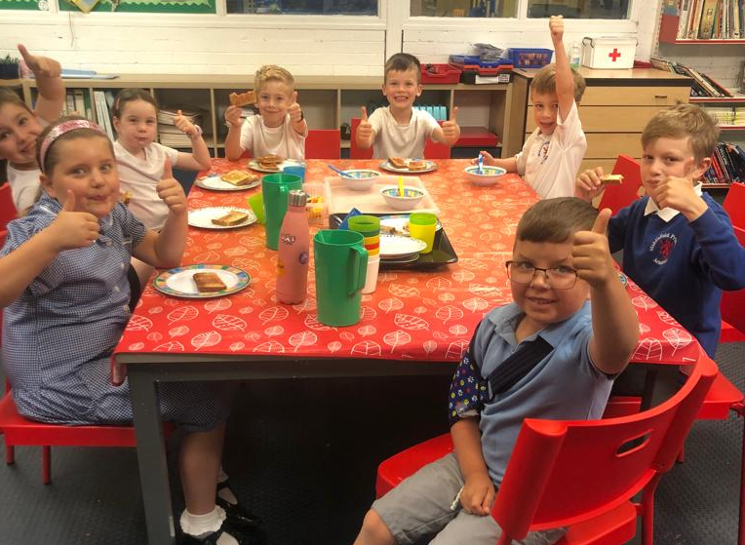
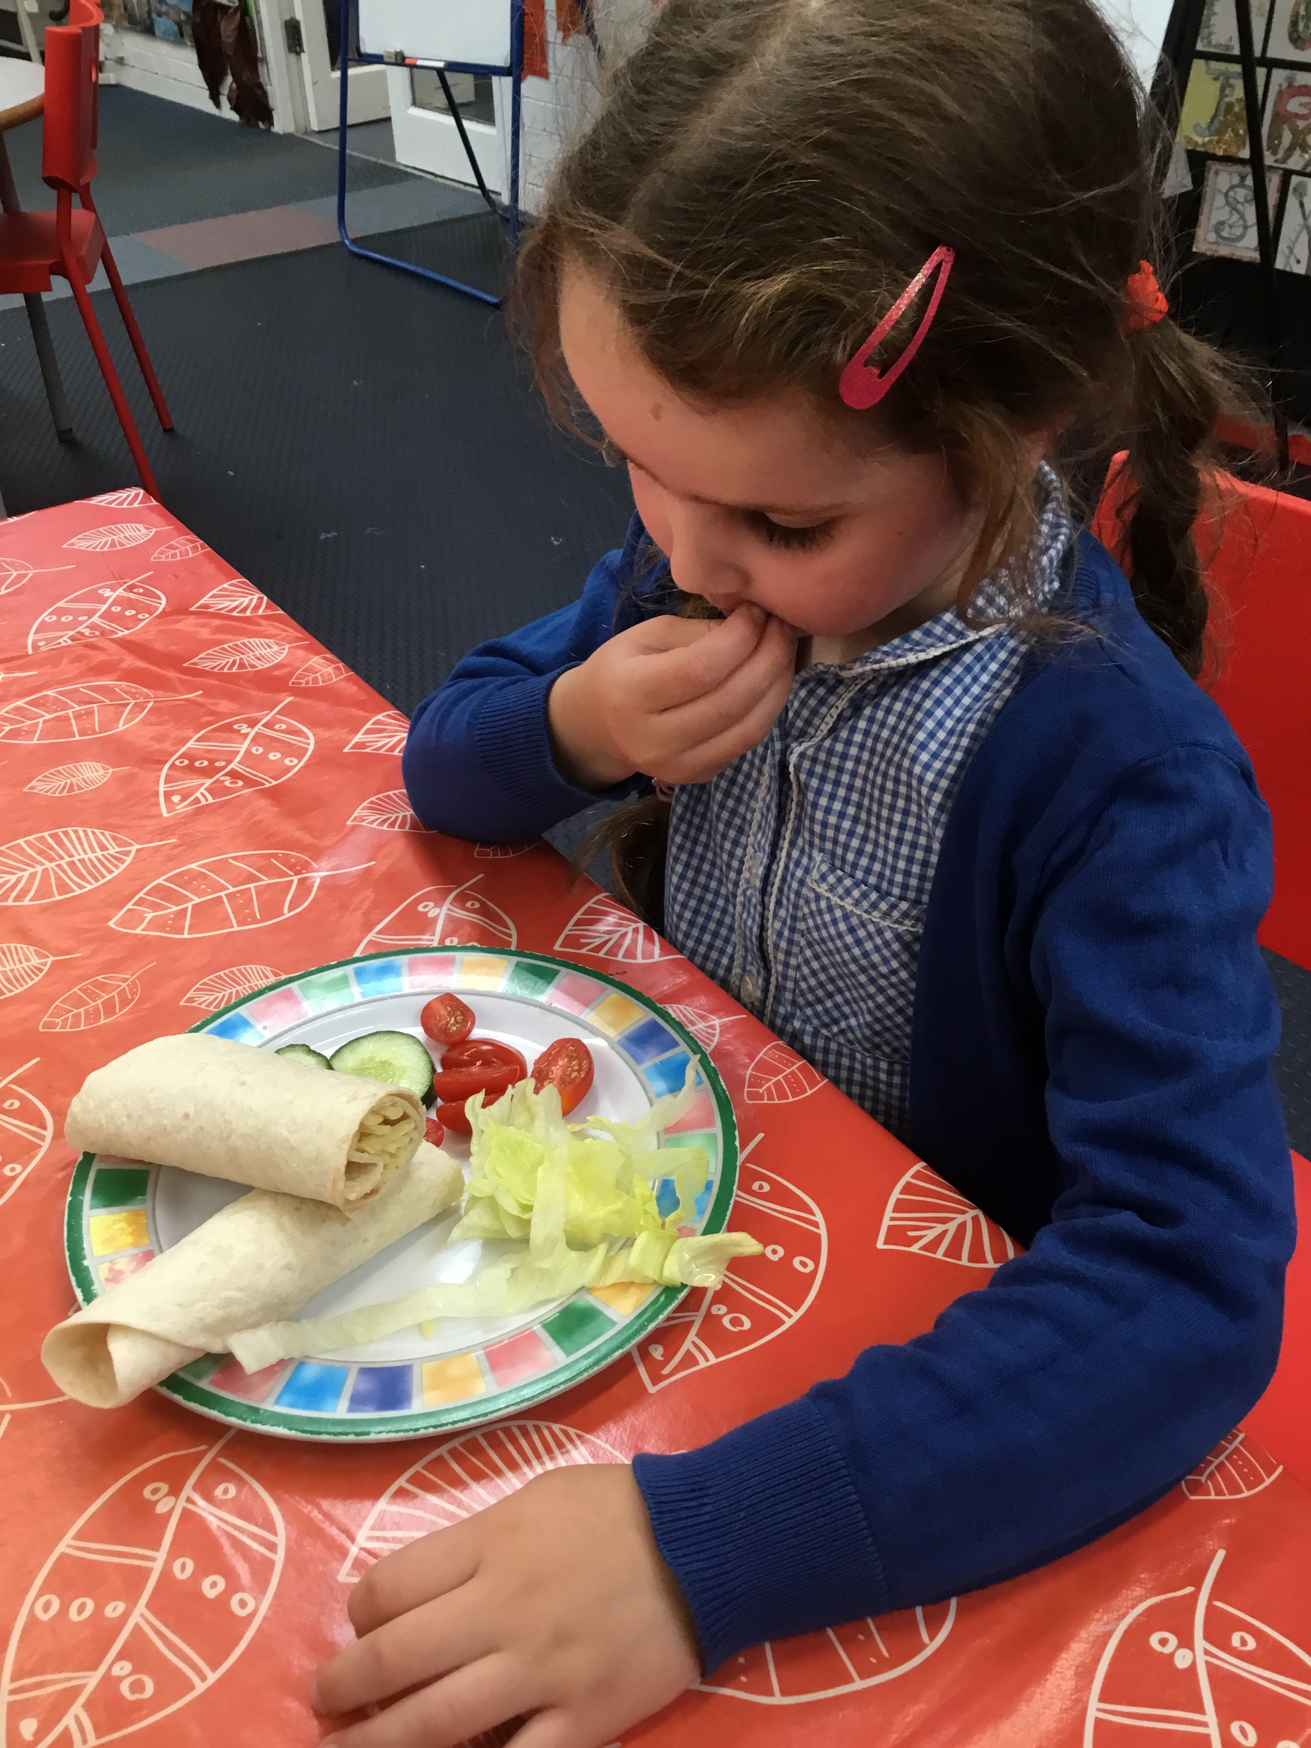




The BASE
Breakfast and After School Experience
Fees for The BASE
Breakfast Club
From 7.35am – 8.35am / 1 hour session (including breakfast) £6.00
From 8.05am – 8.35 /30 minute session (including breakfast) £4.00
After School Club
3.15pm – 4.15pm / 1 hour session (without tea) £5.75
1 hour session - after other school clubs (with tea*) £7.50
1 hour 30 min session (without tea) £7.00
1 hour 30 min session after other school clubs (with tea) £9.25
3.15pm - 5pm /1 hour 45 min (without tea) £9.00
3.15pm - 5pm /1 hour 45 min(with tea) £10.25
2 hour session (without tea) £10.00
2 hour session (with tea) £11.25
3.15pm – 6.00pm (without tea) £11.50
3.15pm – 6.00pm (with tea) £12.75
*Please note: Tea will be served at 4.45pm
There is a sibling discount of 10% discount for 2, 20% discount for 3 etc.
Club closes at 6.00pm. There is a late pick up fee of £5.00 for every 5 minutes per child collected after 6pm.
Cancellation - We require 24 hours notice if you need to cancel a session. If you do not cancel your child’s booking with at least 24 hours notice you will be charged the session fee, unless the child is unwell.
Payments - club statements will show under payments on your child’s Arbor account within 5 days of attendance.
Please log in to the Parent Portal or Arbor App to pay by card, arrange childcare vouchers* or for BACS payments please use the following details: Sort Code: 77-72-20 Account Number: 26909360 Account Name: The Diamond Learning Partnership Trust (please put your child's name/MF in for reference).
*If you arrange childcare vouchers these will be received by our accounts department and may take a few days to be updated on Arbor so please advise the office to prevent further reminders being sent.
Please be reminded to clear each monthly balance to guarantee future club sessions and prevent large account arrears.
Children making persistent poor or unsafe behaviour choices could lose their place at the BASE.
A warm welcome awaits you at The BASE, the out of hours childcare provision at Middlefield Primary Academy.
For information on bookings, please contact the school office: 01480375270

