Slide 1

HEALTHY RELATIONSHIPS PROGRAMME
Aims of the Healthy Relationships Programme:
The programme consists of
six weekly sessions
Session 1
What is a Healthy Relationship
Session 2
Barriers to Healthy Relationships
Session 3
Impact on Children
Session 4
Communication
Session 5
Self Esteem & resilience
Session 6
Self-Care & Celebration
To support participants in recognising what a healthy relationship looks like and to build healthy relationships that will enhance both theirs and their children’s lives.
To help prevent children witness or be exposed to hostility, criticism or violence.

Slide 2

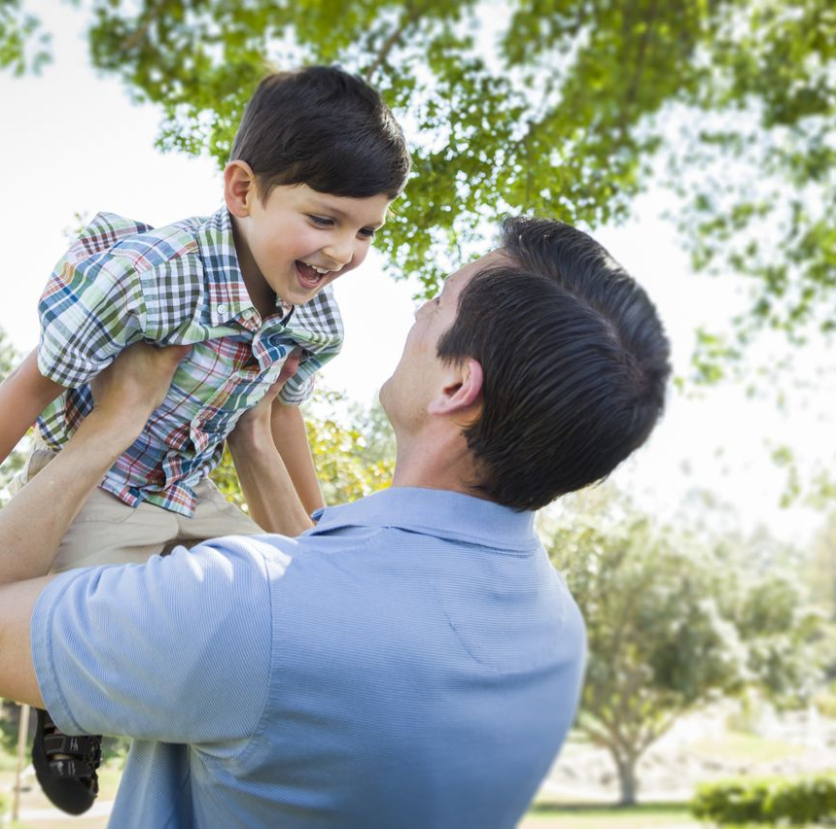

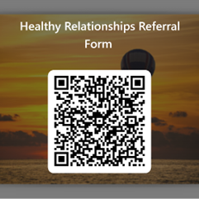
Who can Refer?
The Healthy Relationships Programme:
The programme is delivered by Cambridgeshire District Targeted Support Teams
Facilitated by experienced Family Workers / Young Persons Workers
Provides a non-judgmental and non-threatening environment
Provides a supportive and Inclusive environment
Provides opportunities for signposting to other services
Provides opportunities to meet other parents
Contact us:
Cambridge City
Phil West
phil.west@cambridgeshire.gov.uk
East Cambs
Karen Gladwin
karen.gladwin@cambridgeshire.gov.uk
South Cambs
Caroline Ritchie
Caroline.ritchie@cambridgeshire.gov.uk
Jade Brennan
Jade.brennan@cambridgeshire.gov.uk
March, Chatteris and Whittlesey
Phil West
phil.west@cambridgeshire.gov.uk
Huntingdon & St Ives
Caroline Ritchie
Caroline.ritchie@cambridgeshire.gov.uk
St Neots, Ramsey, Sawtry & Yaxley
Jade Brennan
Jade.brennan@cambridgeshire.gov.uk
Wisbech
Donna Drayton
Donna.drayton@cambridgeshire.gov.uk
Parents
Schools
Family Workers
Social Workers
Health Services

